Slide 1
Chapter 2: Designing Applications

Slide 2
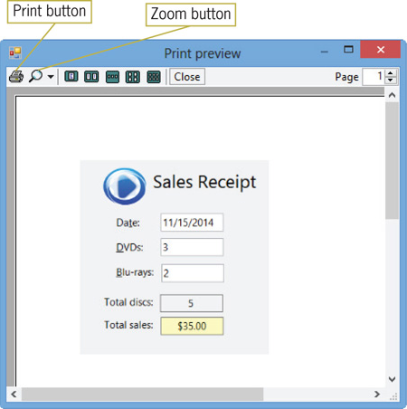
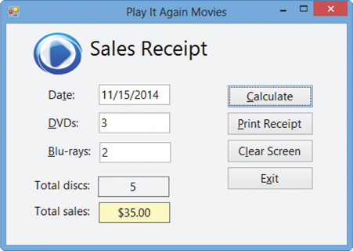
Previewing the Play It Again Movies Application
Play It Again Movies application
Allows salespeople to enter the date and number of DVDs and Blu-rays sold
Calculates and displays the total number of discs ordered and the total sales for the order
Figure 2-2 Completed sales receipt
Figure 2-3 Print preview window

Slide 3
Lesson A Objectives
After studying Lesson A, you should be able to:
Plan an object-oriented Windows application in Visual Basic 2012
Complete a TOE (Task, Object, Event) chart
Follow the Windows standards regarding the layout and labeling of controls

Slide 4
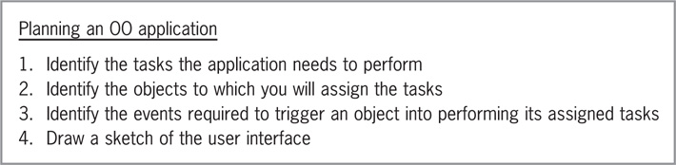
Planning an Object-Oriented Application
Actively involve the user in the planning phase
The end product should closely match the user’s needs and wants
TOE chart
Used to record tasks, objects, and events required for the application
Figure 2-5 Steps for planning an OO application

Slide 5
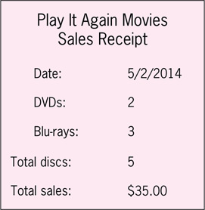
Planning an Object-Oriented Application (cont.)
Identifying the Application’s Tasks
What information will the application need to display on the screen and/or print on the printer?
What information is entered into the user interface?
What information will the application need to calculate to produce the desired result?
How will the user end the application?
Will previous information need to be cleared from the screen before new information is entered?
Figure 2-6 Sample of the store’s current sales receipt

Slide 6
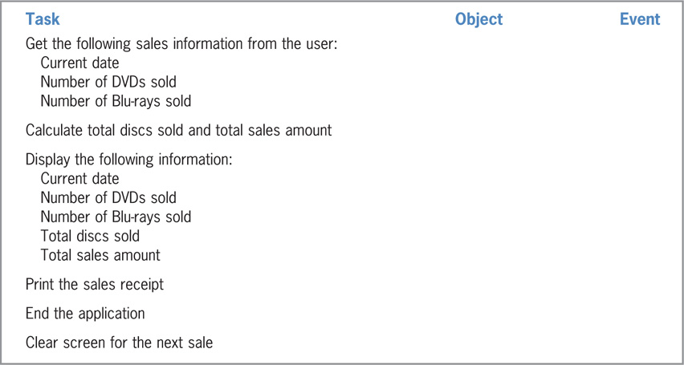
Planning an Object-Oriented Application (cont.)
Figure 2-7 Tasks entered in a TOE chart

Slide 7
Planning an Object-Oriented Application (cont.)
Identifying the Objects
Assign each task to an object in the user interface
Objects used here:
Label control
Displays information that the user should not change
Button control
Performs an action immediately after a Click event
Text box
Provides an area for the user to enter data

Slide 8
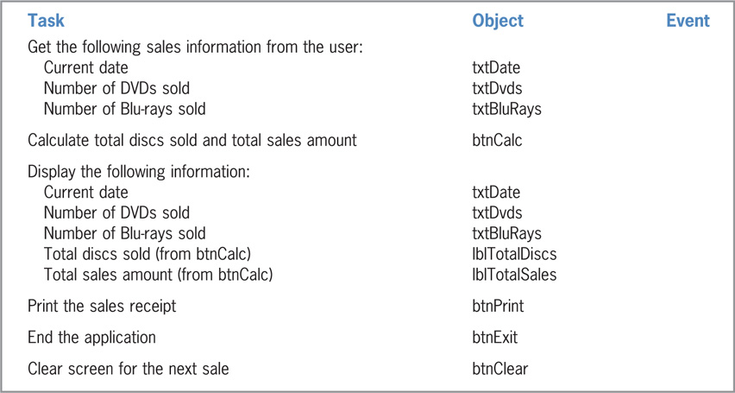
Planning an Object-Oriented Application (cont.)
Figure 2-8 Tasks and objects entered in a TOE chart

Slide 9
Planning an Object-Oriented Application (cont.)
Identifying the Events
Determine which event (if any) must occur for an object to carry out its assigned task
Text boxes and label controls
No special event is needed
btnCalc, btnClear, and btnExit buttons
Perform assigned tasks when clicked

Slide 10
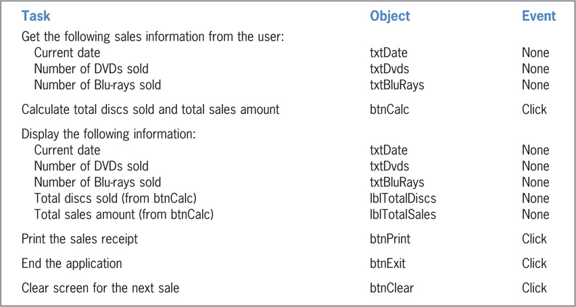
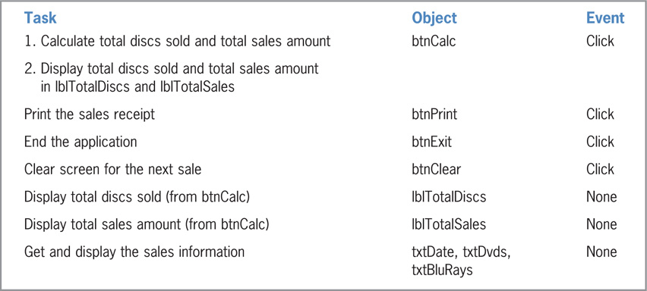
Planning an Object-Oriented Application (cont.)
Figure 2-9 Completed TOE chart ordered by task
Figure 2-10 Completed TOE chart ordered by object

Slide 11
Planning an Object-Oriented Application (cont.)
Drawing a Sketch of the User Interface
Follow Windows standards for designing the interface
In Western countries, information flows either vertically or horizontally
Vertical arrangement:
Information flows from top to bottom, with essential information located in the first column
Horizontal arrangement:
Information flows from left to right, with essential information placed in the first row

Slide 12
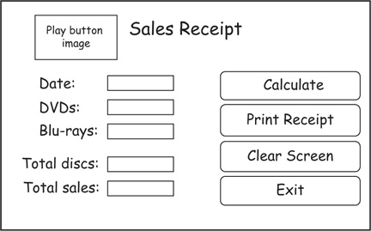
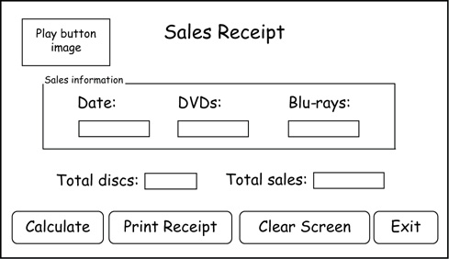
Planning an Object-Oriented Application (cont.)
Figure 2-11 Vertical arrangement of the Play It Again Movies application
Figure 2-12 Horizontal arrangement of the Play It Again Movies application

Slide 13
Planning an Object-Oriented Application (cont.)
White space or containers may be used to group related controls
Containers
Objects used to group related controls
Examples: GroupBox, Panel, TableLayoutPanel
Label controls that display output should have meaningful names
Example: “Total Sales” identifies the lblTotalSales label
Identifying labels should end with a colon (:)
Example: “Total Sales:”

Slide 14
Planning an Object-Oriented Application (cont.)
Sentence capitalization
Only the first letter in the first word is capitalized
Use for identifying labels
Book title capitalization
Capitalize the first letter of each word except articles, conjunctions, and prepositions
Use for button text
Buttons should be aligned
Also same height and width
Group related controls close to each other

Slide 15
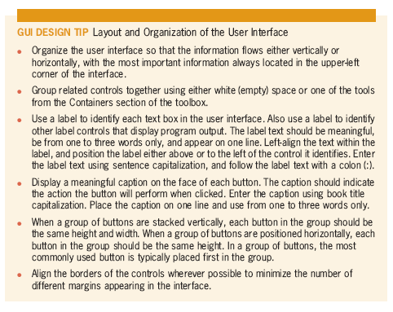
Planning an Object-Oriented Application (cont.)

Slide 16
Lesson A Summary
Steps to create an OO application:
Meet with the client
Plan the application
Identify needed tasks, objects, and events
Identify information needed as input to produce the desired result
Build the user interface
Code the application
Test and debug the application
Assemble the documentation

Slide 17
Lesson B Objectives
After studying Lesson B, you should be able to:
Build the user interface using your TOE chart and sketch
Follow the Windows standards regarding the use of graphics, fonts, and color
Set a control’s BorderStyle, AutoSize, and TextAlign properties
Add a text box to a form
Lock the controls on the form
Assign access keys to controls
Set the TabIndex property

Slide 18
Building the User Interface
Use the TOE chart and sketch as guides when building the user interface
Place appropriate controls on forms
Set applicable properties of controls
Features of the UI used in this lesson’s application:
Information is arranged vertically
Controls are aligned and appropriately labeled
Try to create an interface that no one notices

Slide 19
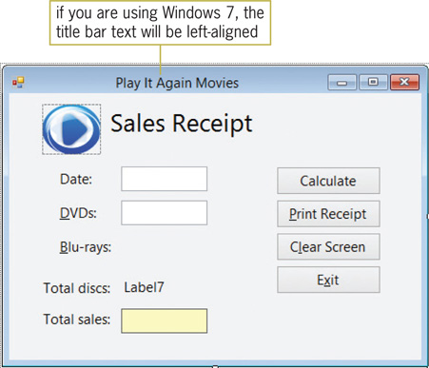
Building the User Interface (cont.)
Figure 2-13 Partially completed interface for the Play It Again Movies application

Slide 20
Building the User Interface (cont.)
Including Graphics in the User Interface
Graphics
Icons or pictures added to an interface
Used to emphasize or clarify a portion of the screen, or for aesthetic purposes
The human eye is attracted to pictures before text
Include graphics sparingly
Graphics for aesthetic use should be small and positioned to avoid distracting the user

Slide 21
Building the User Interface (cont.)
Selecting Fonts for the Interface
GUI DESIGN TIP: Selecting Font Types, Styles, and Sizes
Use only one font type—typically Segoe UI (pronounced “see-go”)—for all of the text in the interface
Use no more than two different font sizes in the interface
Avoid using italics and underlining because both font styles make text difficult to read
Limit the use of bold text to titles, headings, and key items that you want to emphasize

Slide 22
Building the User Interface (cont.)
Adding Color to the Interface
Build the interface using black, white, and gray; only add color if you have a good reason to do so
Use white, off-white, or light gray for the background; use black for the text
Never use a dark color for the background or a light color for the text; a dark background is hard on the eyes, and light-colored text can appear blurry
Limit the number of colors in an interface to three, not including white, black, and gray; the colors you choose should complement each other
Never use color as the only means of identifying an element in the interface

Slide 23
Building the User Interface (cont.)
The BorderStyle, AutoSize, and TextAlign Properties
The BorderStyle property can be set to None, FixedSingle, or Fixed3D
None is used for labels
FixedSingle surrounds the control with a thin line
Used for labels that display program output
Fixed3D gives the control a three-dimensional appearance
Used for text boxes
The AutoSize property determines if a control automatically sizes to fit its current contents
Typically set to false for label controls that display program output
The TextAlign property can be set to nine different values

Slide 24
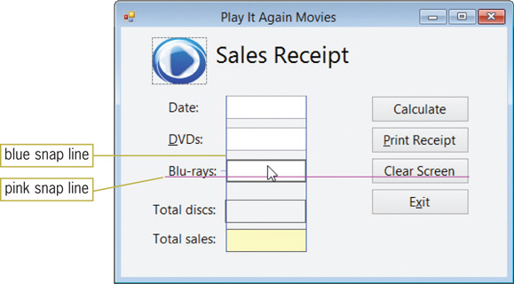
Building the User Interface (cont.)
Adding a Text Box Control to the Form
A text box control provides an area for data entry
Use the TextBox tool to add a text box control
Make all text boxes the same size and align them using snap lines
Blue snap lines are used for vertical alignment
Pink snap lines are used for horizontal alignment
Figure 2-14 Snap lines shown in the interface

Slide 25
Create the UI

Slide 26
Locking the Controls on a Form
Lock controls after they are properly placed to avoid inadvertently moving them
A locked control is identified by a small lock
To lock controls:
Right-click the form (or any control on the form)
Click Lock Controls on the FORMAT menu
Follow the same procedure to unlock controls

Slide 27
Assigning Access Keys
Access key
Enables an object to be selected using the keyboard
Key combination: Alt key + letter or number
Each access key must be unique
Shown in the interface as an underlined letter
To assign an access key, include an ampersand (&) in the control’s caption
Example: “&Calculate Order” assigns ‘C’ to the button

Slide 28
Assigning Access Keys (cont.)
Reasons to assign access keys:
Allow the user to work even if the mouse does not
Allow fast typists to keep their hands on the keyboard
Allow people with disabilities that prevent them from using a mouse to be able to use an application
Follow Windows standards for assigning commonly used access keys

Slide 29
Controlling the Tab Order
Focus
The state in which a control is ready to accept user input or action
Pressing the Tab key or access key shifts the focus
TabIndex property
A number representing the order in which a control will receive the focus when the user presses the Tab key
A control with a TabIndex of 0 receives the focus first
Set TabIndex using the Properties window or the Tab Order option on the VIEW menu
Make a list of objects to determine the proper order

Slide 30
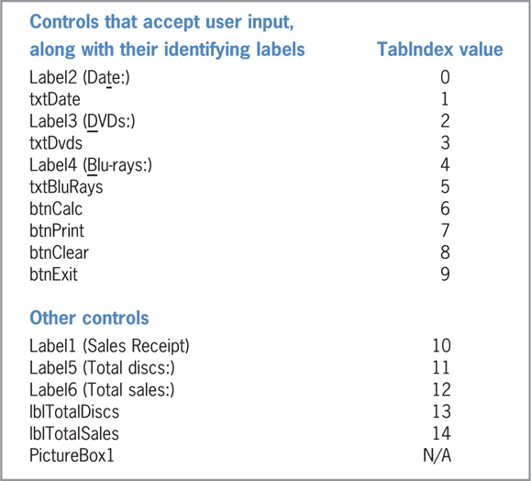
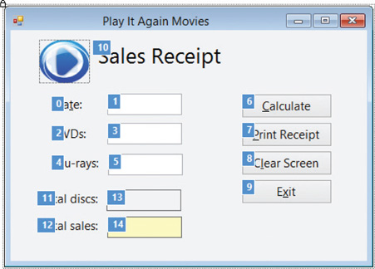
Controlling the Tab Order (cont.)
Figure 2-16 TabIndex boxes showing the correct TabIndex values
Figure 2-15 List of controls and TabIndex values

Slide 31
Coding the Application
Code
Instructions added to an application
Coding is done after planning and building the interface
TOE charts show which objects and events need to be coded
Play It Again Movies application code requirements:
Four buttons associated with Click events

Slide 32
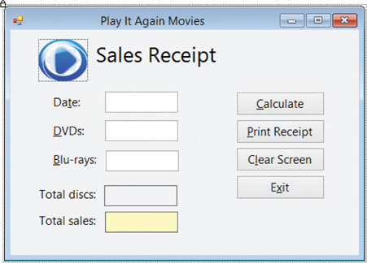
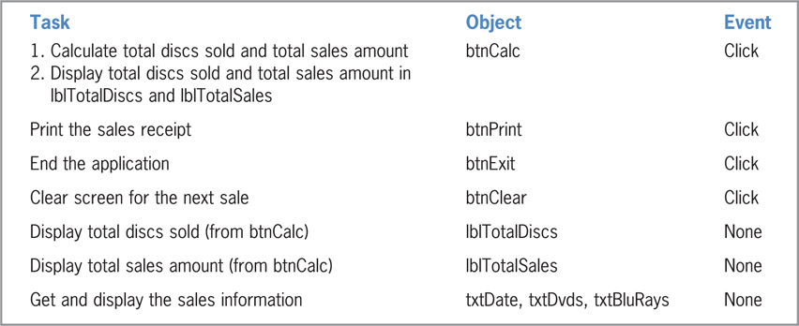
Coding the Application (cont.)
Figure 2-21 Play It Again Movies user interface from Lesson B
Figure 2-22 TOE chart (ordered by object) for Play It Again Movies

Slide 33
Coding the Application (cont.)
Using Pseudocode to Plan a Procedure
Pseudocode
Short phrases used to describe the steps a procedure must take to accomplish its goal
Travel directions are a type of pseudocode
btnCalc Click event procedure
Calculates the total number of discs ordered and the total price
Displays the results at run time

Slide 34
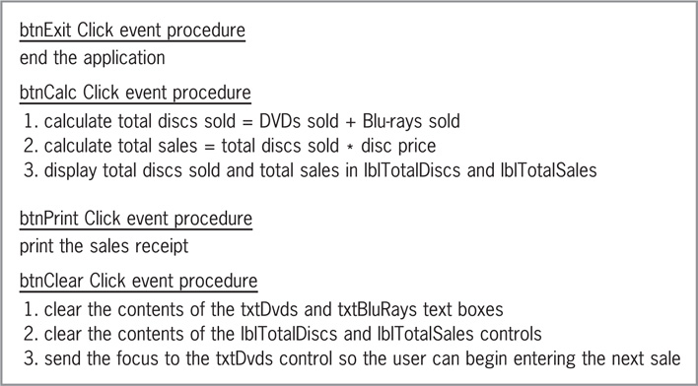
Coding the Application (cont.)
Figure 2-23 Pseudocode for the Play It Again Movies application

Slide 35
Coding the btnClear Control’s Click Event Procedure
btnClear control’s task
Clear the screen for the next order
String
Zero or more characters enclosed in quotation marks ("")
Zero-length string (or empty string)
A pair of quotation marks with nothing between them ("")
Two ways to remove the control contents at run time:
Assign a zero-length string to the control’s Text property
Assign String.Empty to the control’s Text property

Slide 36
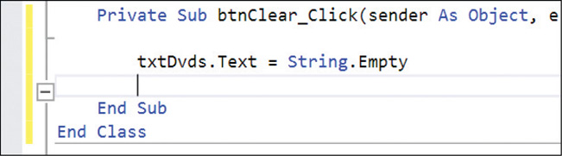
Coding the btnClear Control’s Click Event Procedure (cont.)
Assigning a Value to a Property During Run Time
Assignment statement
An instruction assigning a value to an object at run time
Syntax: object.property = expression
object and property are the object and property names
expression contains the value to be assigned
Assignment operator (=)
Assigns the value on the right side to the object on the left side
Figure 2-27 First assignment statement entered in the procedure

Slide 37
Coding the btnClear Control’s Click Event Procedure (cont.)
Using the Focus Method
Allows you to move the focus to a specified control during run time
Syntax: object.Focus()
object is the name of the control that receives the focus

Slide 38
Coding the btnClear Control’s Click Event Procedure (cont.)
Internally Documenting the Program Code
Comments
Internal documentation in a program
Used by programmers to document a procedure’s purpose or explain sections of code
Help make code readable
To create a comment, place an apostrophe (’) before a statement
The computer ignores all characters after the apostrophe for the rest of the line
Comments are color-coded in the IDE

Slide 39
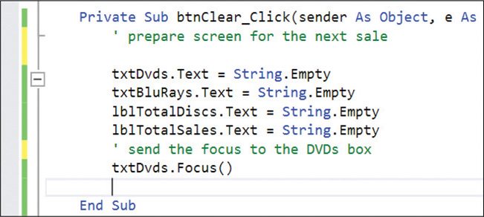
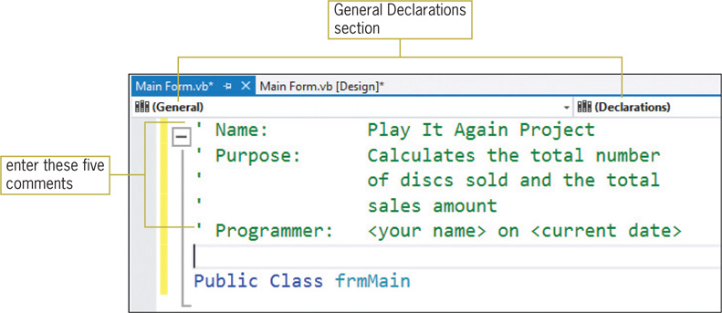
Coding the btnClear Control’s Click Event Procedure (cont.)
Figure 2-28 btnClear control’s Click event procedure
Figure 2-29 Comments entered in the General Declarations section

Slide 40
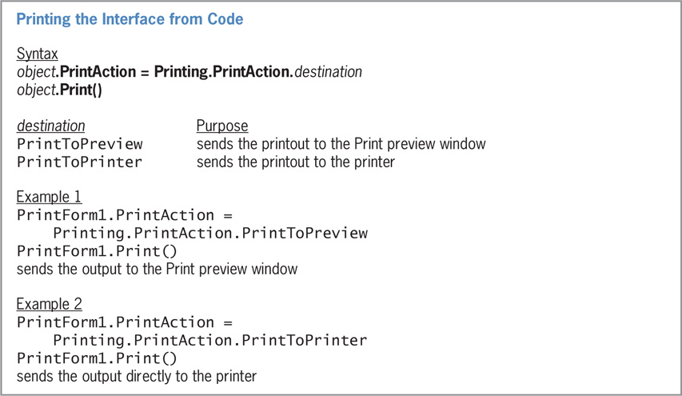
Coding the btnPrint Control’s Click Event Procedure
Figure 2-30 Syntax and examples of printing the interface from code

Slide 41
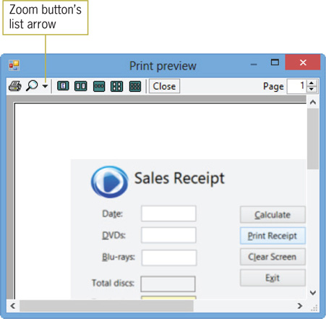
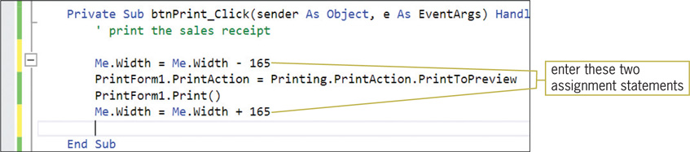
Coding the btnPrint Control’s Click Event Procedure (cont.)
Figure 2-32 Print preview window
Figure 2-33 Completed Click event procedure for the btnPrint control

Slide 42
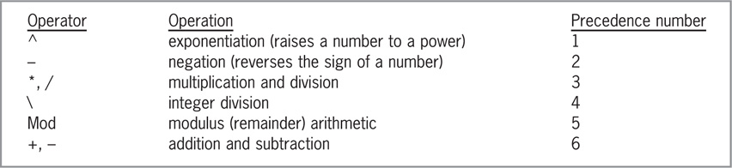
Writing Arithmetic Expressions
Figure 2-34 Most commonly used arithmetic operators
Order of operations:
PEMDAS (Parentheses, Exponents, Multiplication, Division, Addition, Subtraction)
Integer division operator
Returns a whole number
Modulus operator
Returns the remainder of the division

Slide 43
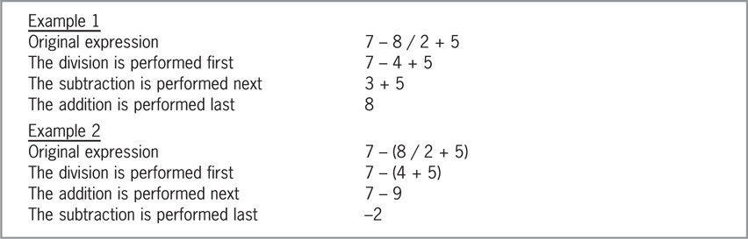
Writing Arithmetic Expressions (cont.)
Figure 2-36 Expressions containing more than one operator having the same precedence

Slide 44
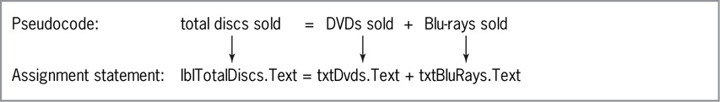
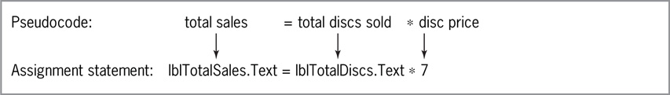
Coding the btnCalc Control’s Click Event Procedure
Figure 2-37 Illustration of the total discs sold calculation
Figure 2-38 Illustration of the total sales calculation

Slide 45
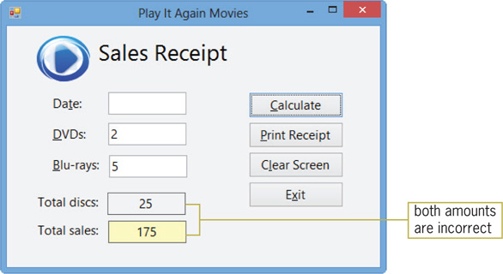
Coding the btnCalc Control’s Click Event Procedure (cont.)
The Val Function
A function is a predefined procedure that performs a task and returns a value
Val temporarily converts a string to a number and returns the number
Syntax: Val(string)
You can use Val to correct calculations in the btnCalc control’s Click event procedure
Figure 2-39 Interface showing the incorrect results of the calculations

Slide 46
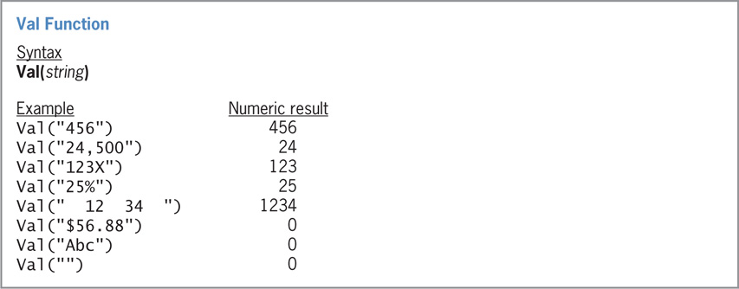
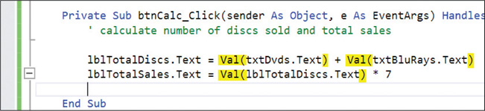
Coding the btnCalc Control’s Click Event Procedure (cont.)
Figure 2-40 Syntax and examples of the Val function
Figure 2-41 Val function entered in the assignment statements

Slide 47
Coding the btnCalc Control’s Click Event Procedure (cont.)
The Format Function
Improves the appearance of numbers
Syntax: Format(expression, style)
expression: Specifies the number, date, time, or string to format
style: A predefined or user-defined format style
Currency: Example of a format style that displays a number with a dollar sign and two decimal places

Slide 48
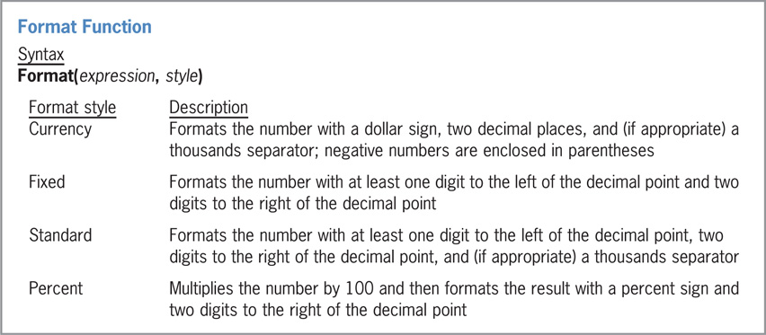
Coding the btnCalc Control’s Click Event Procedure (cont.)
Figure 2-43 Format function’s syntax and some of the predefined format styles

Slide 49
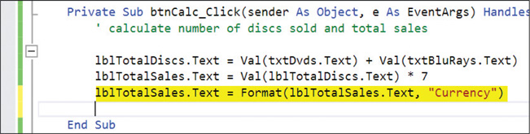
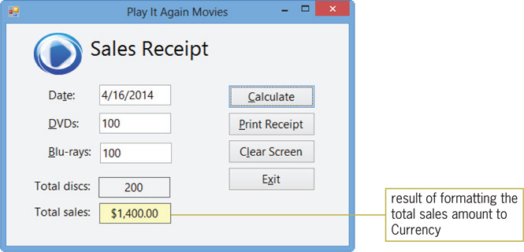
Coding the btnCalc Control’s Click Event Procedure (cont.)
Figure 2-44 Format function entered in the procedure
Figure 2-45 Formatted total sales amount shown in the interface

Slide 50
Testing and Debugging the Application
Test an application using some sample data
Use both valid and invalid data
Valid data
Data that the application is expecting
Invalid data
Data that the application is not expecting
Debugging
The process of locating and correcting errors in a program
Errors can be related to either syntax or logic

Slide 51
Testing and Debugging the Application (cont.)
Syntax error
Occurs when a rule of a programming language is broken
Typos
Logic error
Occurs when the syntax is correct, but the outcome is not what was desired
Causes may include missing instructions, instructions out of order, or the wrong type of instruction
Run time error
Occurs when an application is running and the application stops

Slide 52
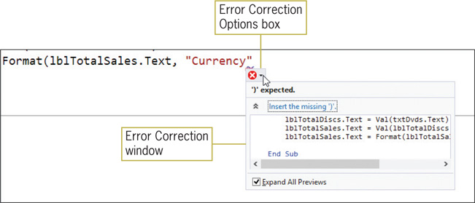
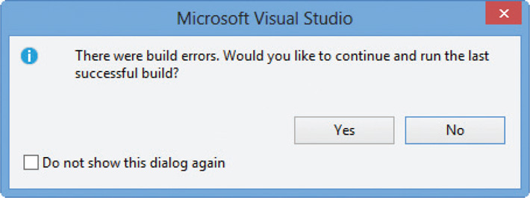
Testing and Debugging the Application (cont.)
Figure 2-46 Suggestion for fixing the error
Figure 2-47 Message dialog box

Slide 53
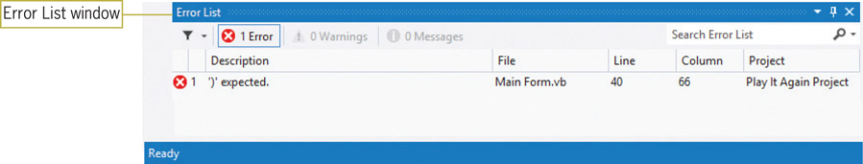
Testing and Debugging the Application (cont.)
Figure 2-48 Error List window in the IDE

Slide 54
Assembling the Documentation
Important documentation
Planning tools
Printout of the application’s interface and code
Your planning tools include:
TOE chart
Sketch of interface
Flowcharts and/or pseudocode

Slide 55
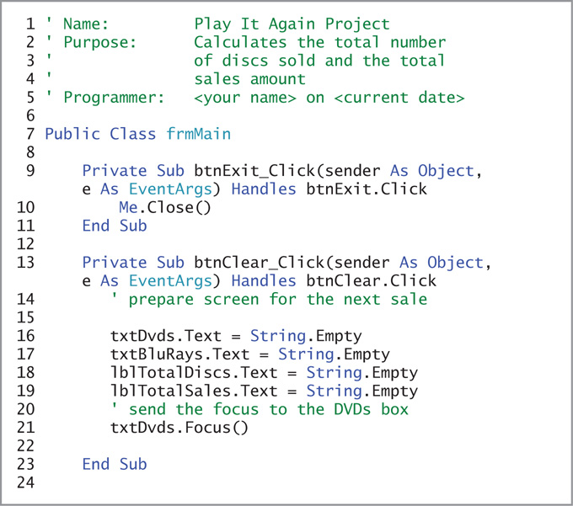
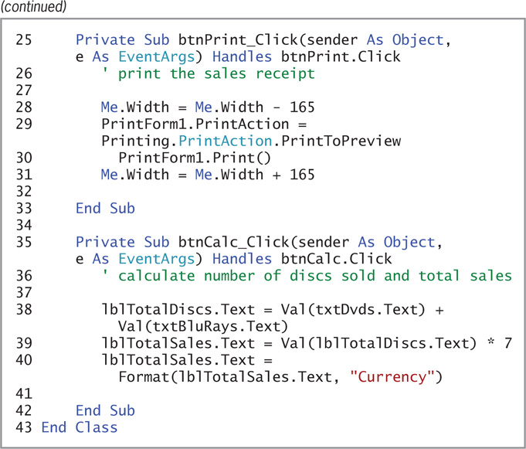
Assembling the Documentation (cont.)
Figure 2-49 Play It Again Movies code

Slide 56
Lesson C Summary
Use pseudocode or a flowchart to plan an object’s code
To assign a value to the property of an object while an application is running, use an assignment statement with the syntax object.property = expression
To create comments, begin the comment text with an apostrophe (’)
Use the integer division operator (\) to divide and return an integer result

Slide 57
Lesson C Summary (cont.)
Use the modulus operator to divide two numbers and return the remainder
Use the PrintForm tool to print the form
To temporarily convert a string to a number, use the Val function
Use the Format function to improve the appearance of numbers
The application should be tested with both valid and invalid data

